Slide 1

Student’s Dropout Prediction

Slide 2

The Problem
What is the problem?
Predicting student dropout in online learning.
Who has this problem?
Student dropping out is one of the most complicated problems faced by universities
Why should this problem be solved?
Predicting student dropout can effectively help reduce social and economic costs.
How is the problem formulated?
How to make early predictions of student dropout in online learning so that lecturers and administrators can carry out appropriate interventions to reduce their retention by building a predictive analysis model using three algorithms: Logistics Regression, Naïve Bayes and Decision Tree along with an Ensemble method.

Slide 3

Related Work 1
Project is based on IEEE paper - Machine Learning Algorithms for Early Predicting Dropout Student Online Learning (ISBN - 979-8-3503-7012-6).
Research study in this paper seeks to predict if a student would fail their course with the help of Naïve Bayes, Logistic Regression with Laso, Logistic Regression with Ridge, and Super Vector Machine algorithms.

Slide 4
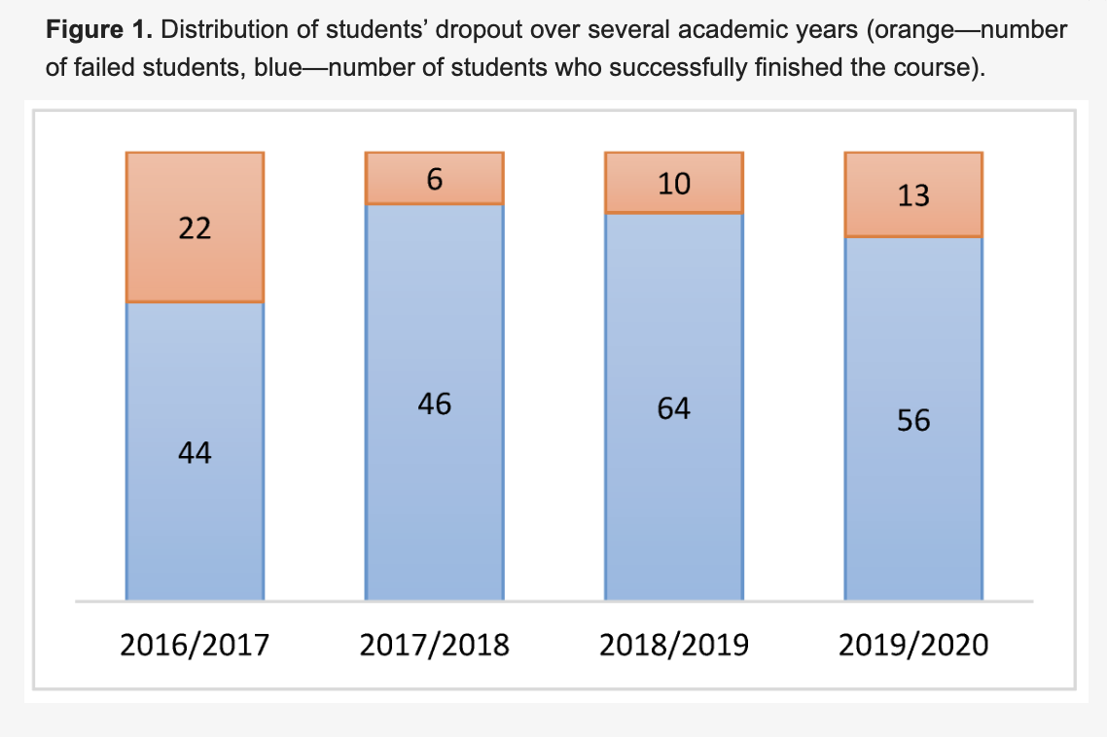
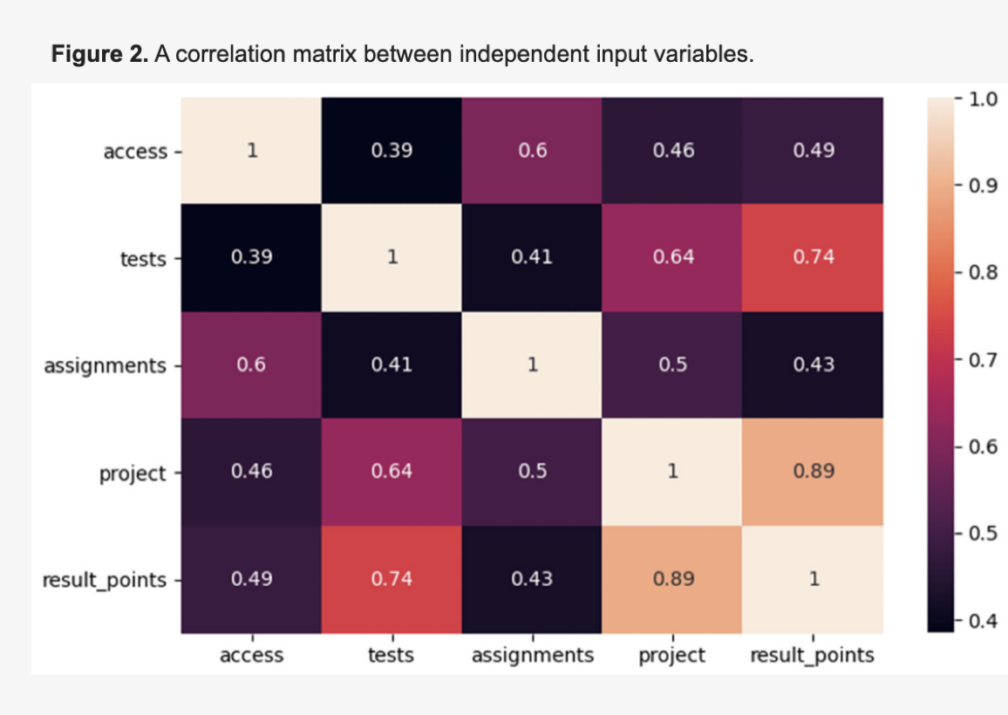
Related work 2
J. Niyogisubizo, L. Liao, E. Nziyumva, E. Murwanashyaka, and P. C. Nshimyumukiza, “Predicting student’s dropout in university classes using two-layer ensemble machine learning approach: A novel stacked generalization,” Computers and Education: Artificial Intelligence, vol. 3, p. 100066, 2022, doi: 10.1016/j.caeai.2022.100066.
Six well-known machine learning algorithms were compared.
Naïve Bayes (NB), Random Forest (RF), Neural Network (NN), Logistic Regression (LR), Support Vector Machines (SVM) and Decision Tree (DT)
Dataset: Activity of 261 third-year students in a university course. Data anonymization was performed during the extraction process to protect student privacy.
Standard pre-processing procedures were followed.
The proportion of dropout students was determined for each academic year.
Notably, 21.92% of students in total failed to pass the course, as indicated in Figure 1.
A standard correlation analysis (Figure 2) was conducted to assess the relationships between individual independent variables and final results.
Medium correlation existed between key attributes and the resulting number of points at the course's conclusion, which aligns with expectations.
Notably, variables "project" and "tests" exhibited slightly stronger correlations with "result_points" compared to other attributes.
It was inferred that these variables have a more significant impact on the final outcome
Due to the importance of early prediction for timely intervention, the variables "access," "assignments," and "tests" were identified as the most critical features for predictive modeling.

Slide 5
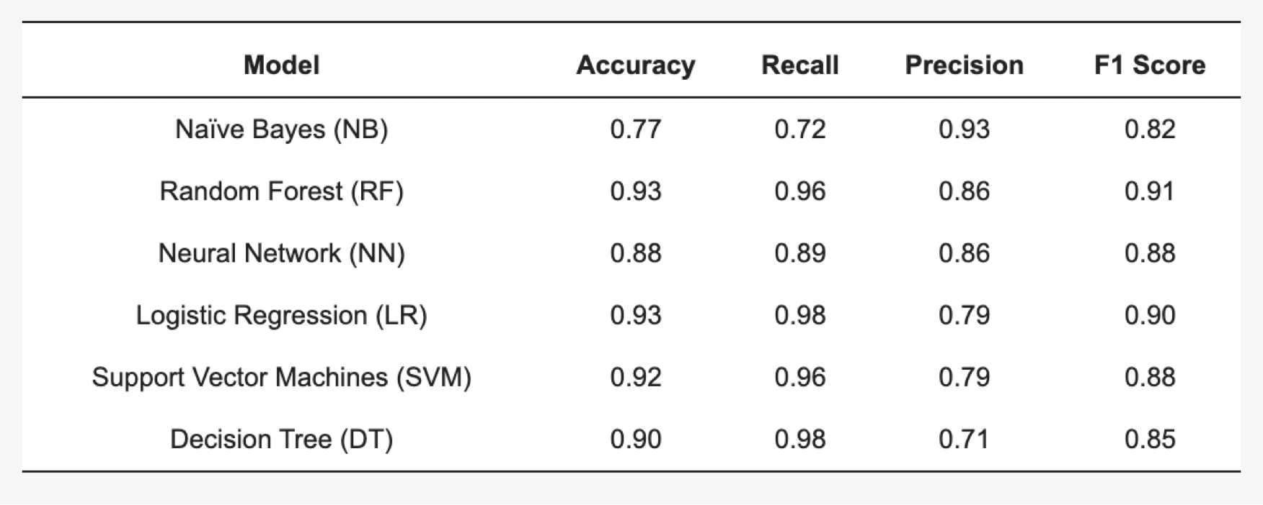

Related Work 2(cont’d)
Training and Testing:
Models were trained and tested across three academic years.
Balanced dataset was used to ensure fair evaluation.
Evaluation metrics were recorded for completers(graduates) and non-completers(dropouts) categories.
Evaluation on unseen data:
Models were evaluated on unseen data from the fourth academic year.
Performance metrics was used for evaluation.
Training and Testing:
Random Forest (RF) classifier exhibited the best dropout prediction.
Evaluation based on precision, recall, accuracy, and F1 scores.
LR, SVM, and DT algorithms performed second-best with marginal differences compared to RF.
Naïve Bayes and Neural Network models showed inferior results and were deemed inaccurate for this dataset

Slide 6
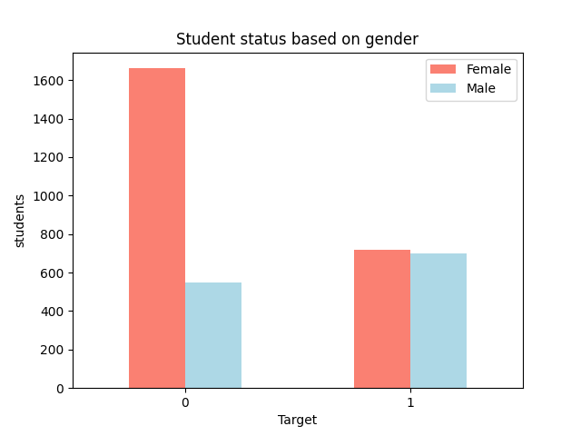
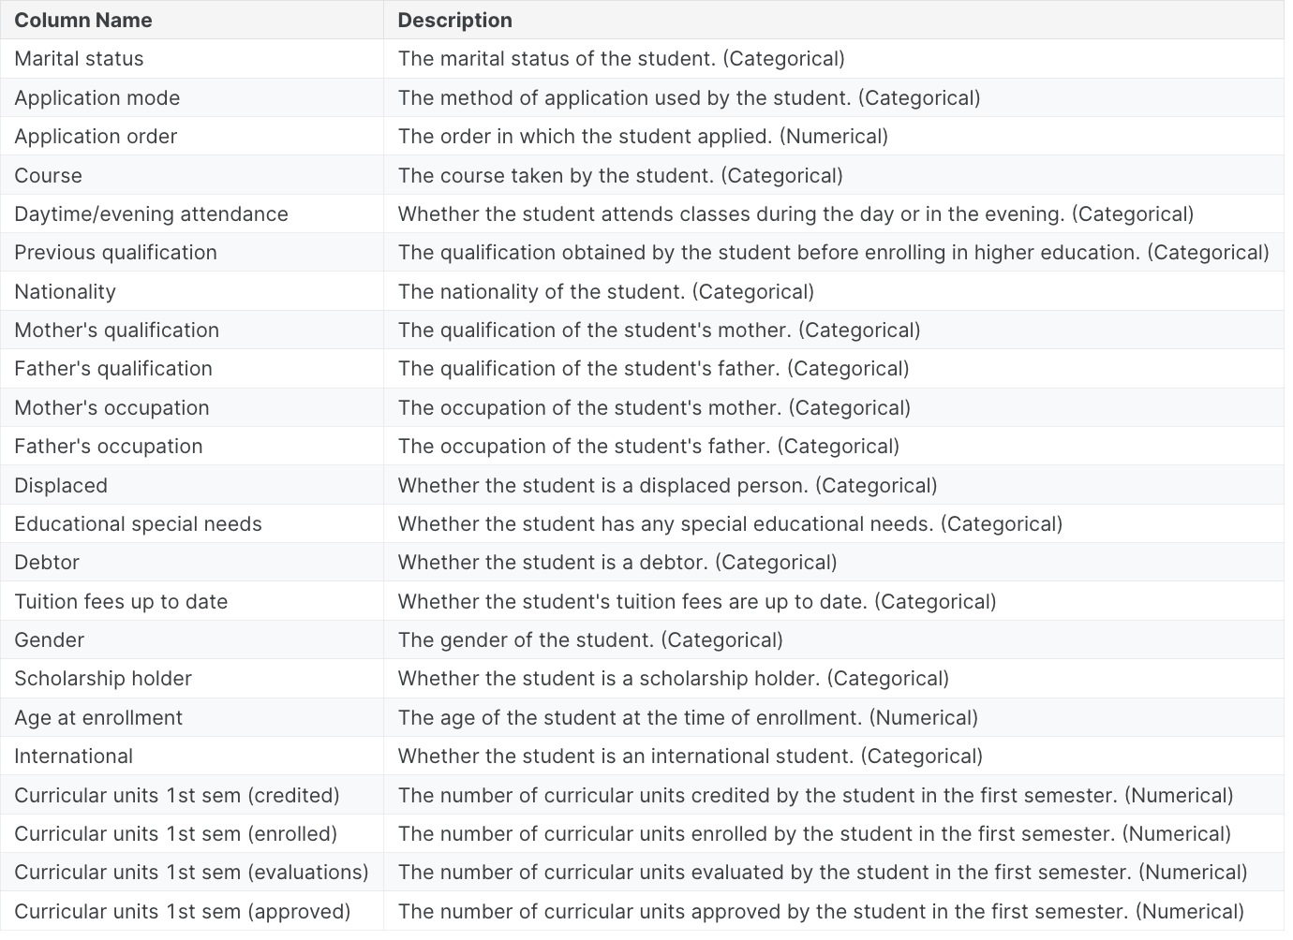
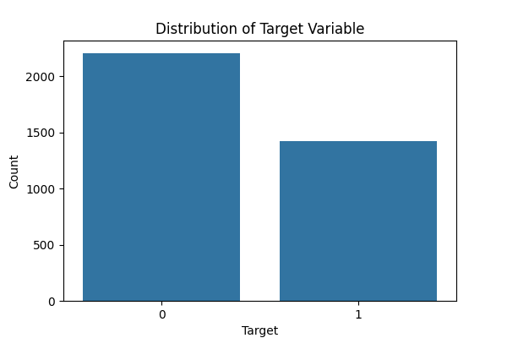
Dataset:
Dataset sourced from UCI Machine Learning Repository.
Comprehensive view of undergraduate students' demographics, socioeconomic factors, and academic performance.
Structured in tabular format: rows represent students, columns represent attributes.
Ideal for analyzing predictors of student dropout and academic success across disciplines.

Slide 7
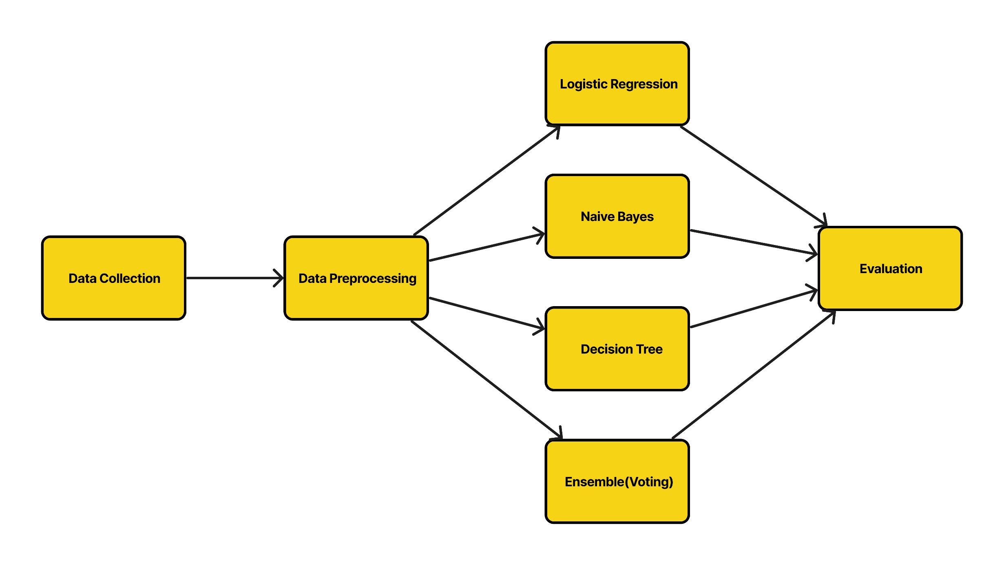
Approach:

Slide 8
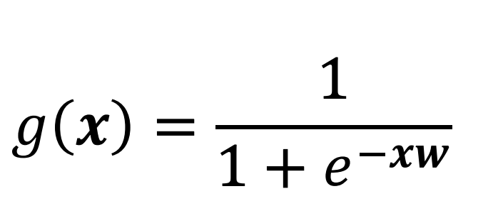
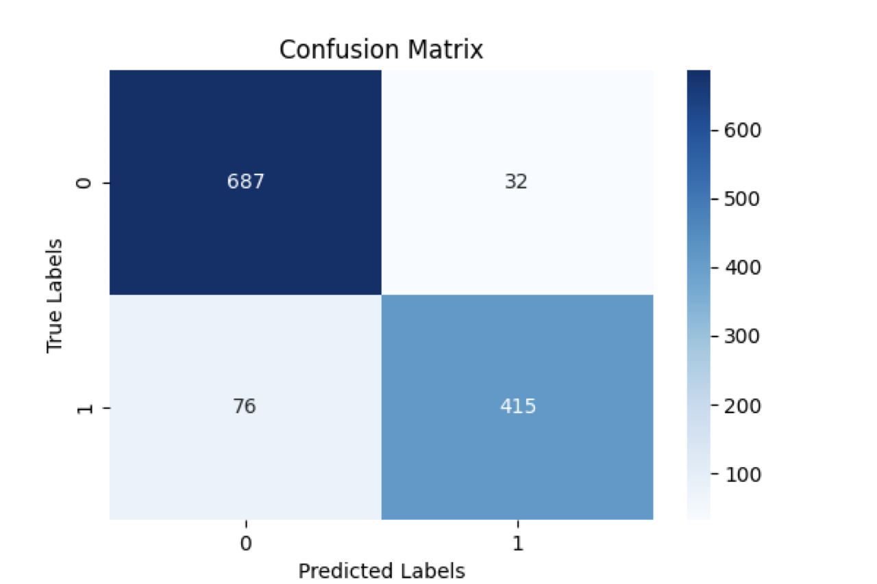
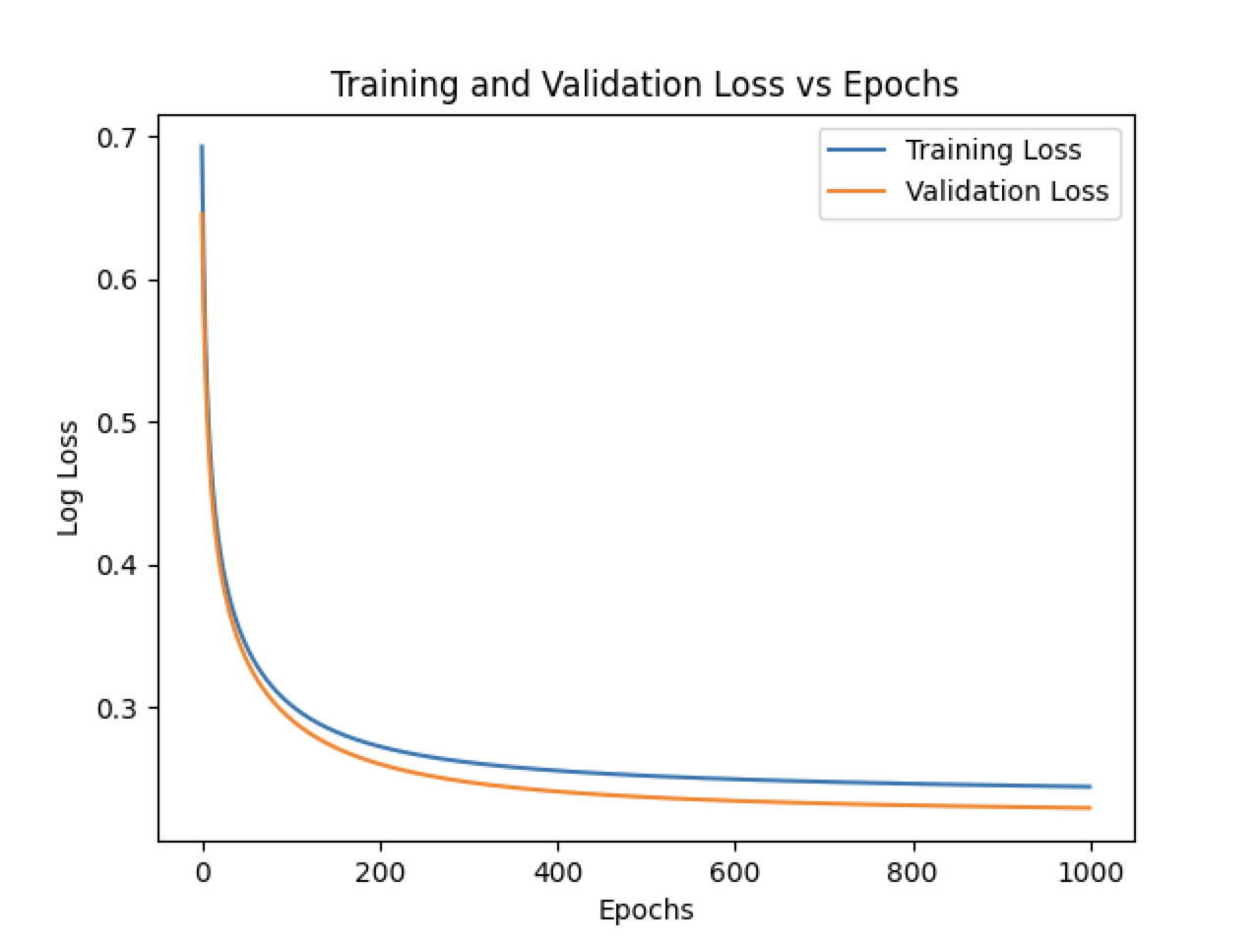
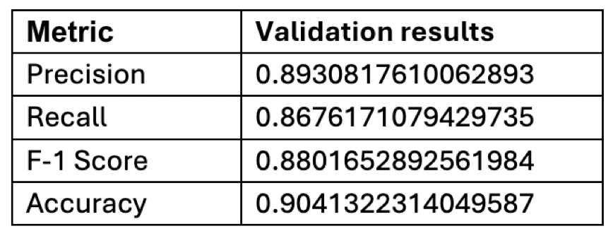
Results and Analysis:
Logistic Regression
Data pre-processing
Categorical feature were encoded (converted to numerical values).
The data is filtered to exclude students who are 'Enrolled' since the target variable of interest is whether a student drops out or not.
Certain columns that are deemed unnecessary for the modeling process are dropped from the dataset. These columns include information such as international status, nationality, parental occupation and qualification, unemployment rate, application order, GDP, and inflation rate.
Data randomized with a seed of 0 and split into 2/3 training and 1/3 validation sets.
The features are standardized to have a mean of 0 and a standard deviation of 1. This ensures that all features are on the same scale, which can help the optimization algorithm converge faster and prevent certain features from dominating others due to differences in scale.

Slide 9
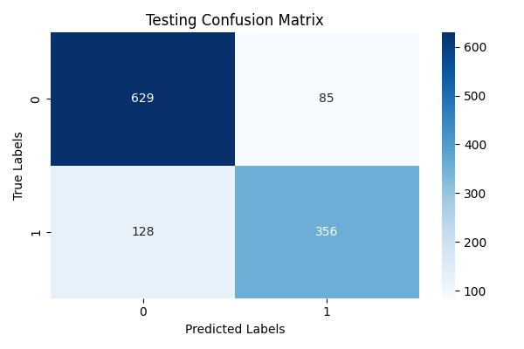
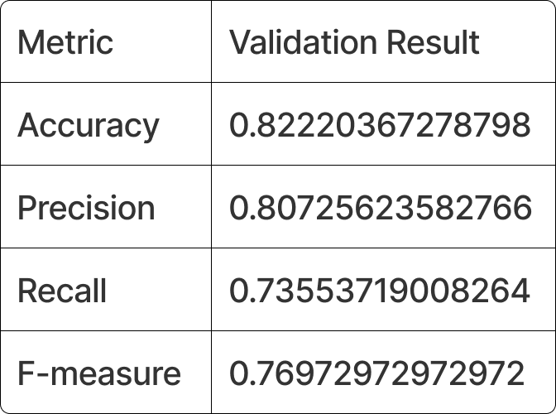
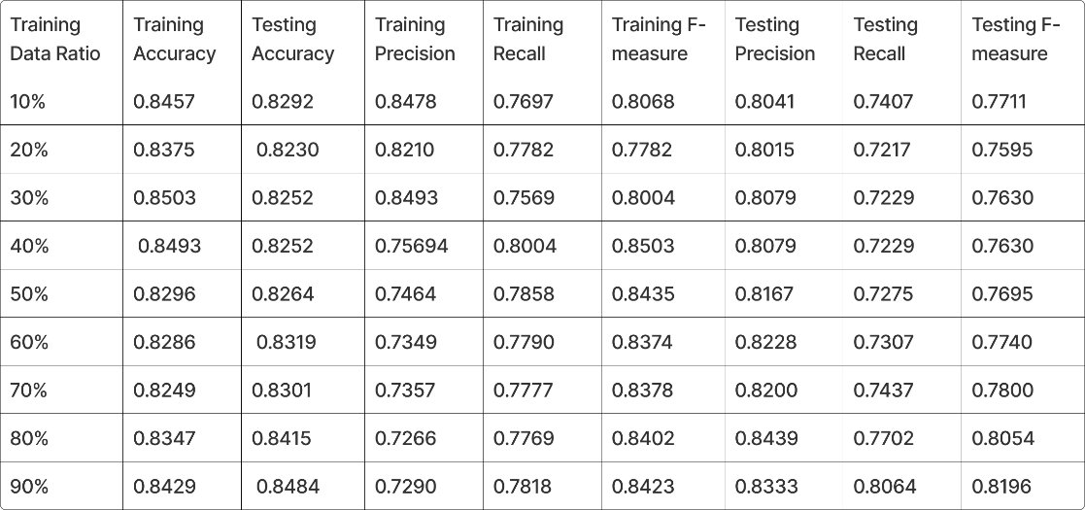
Results and Analysis:
Naïve Bayes
Data pre-processing
Categorical feature were encoded (converted to numerical values).
The data is filtered to exclude students who are 'Enrolled' since the target variable of interest is whether a student drops out or not.
Certain columns which are not pertinent for the modeling process are dropped from the dataset.
Data randomized with a seed of 42 and split into 2/3 training and 1/3 validation sets.
The ’Target’ variable is converted into a binary format. ’Dropout’ is encoded as 1, and other classes are encoded as 0.

Slide 10
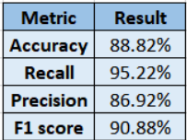
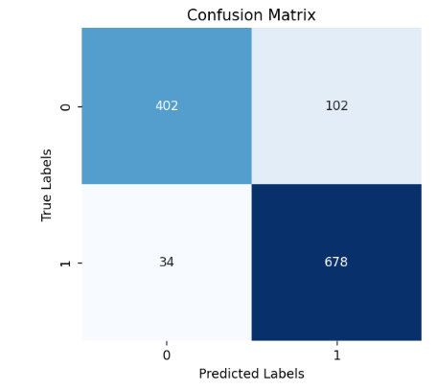
Results and Observations
Decision Trees
Experimentation:
ID3 algorithm implementation
Data Pre-processing:
Target data encoding → {Graduate – 1; Dropout – 0}
Data is scaled, simulating Sklearn’s StandardScaler.
Parameter Hypertuning:
Max Depth
Minimum Samples Split
Minimum Samples Leaf
Observations:

Slide 11
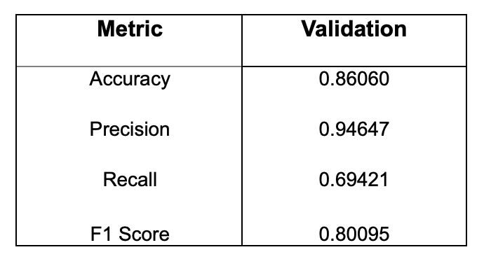
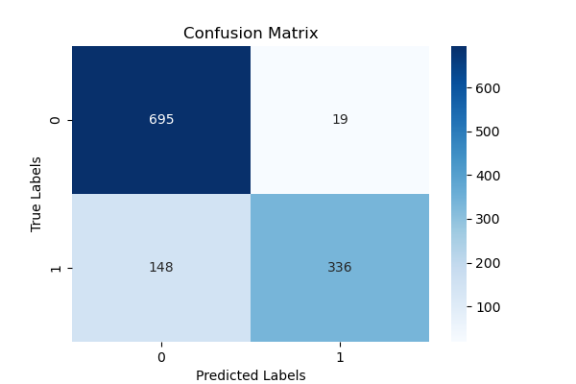
Results and Analysis:
Ensemble
The ensemble technique employed is a majority voting classifier, which combines the predictions of multiple base classifiers to make the final prediction.
The dataset was divided into training and validation sets using a 67-33 split.
Within each base classifier, the training data was used for model fitting and parameter tuning.

Slide 12
Conclusion
Models Analyzed:
Logistic Regression: Naïve Bayes: Decision Trees: Ensemble:
Metric | Result
Accuracy | 90.41%
Recall | 86.76%
Precision | 89.30%
F1 score | 88.01%
Metric | Result
Accuracy | 82.22%
Recall | 73.55%
Precision | 80.72%
F1 score | 76.97%
Metric | Result
Accuracy | 88.82%
Recall | 95.22%
Precision | 86.92%
F1 score | 90.88%
Metric | Result
Accuracy | 86.06%
Recall | 69.42%
Precision | 94.64%
F1 score | 80.09%

Slide 13
Future Extensions
Data and Feature Exploration:
Incorporating more diverse and comprehensive datasets.
Investigating the impact of additional feature sets and data augmentation techniques on model performance.
Enhancing data preprocessing and cleaning methodologies.
Application to New Domains:
Applying the models and methodologies developed in this study to other industries or fields to assess their versatility and adaptability.
Exploring cross-disciplinary applications, particularly where Students’ dropout intersects with social, economic, or environmental factors.
Application to New Domains:
Leveraging emerging technologies to enhance computational efficiency and model scalability.
Incorporating state-of-the-art hardware and software solutions to address current limitations in processing power and data storage.

Slide 14
THANK YOU

